Slide 1
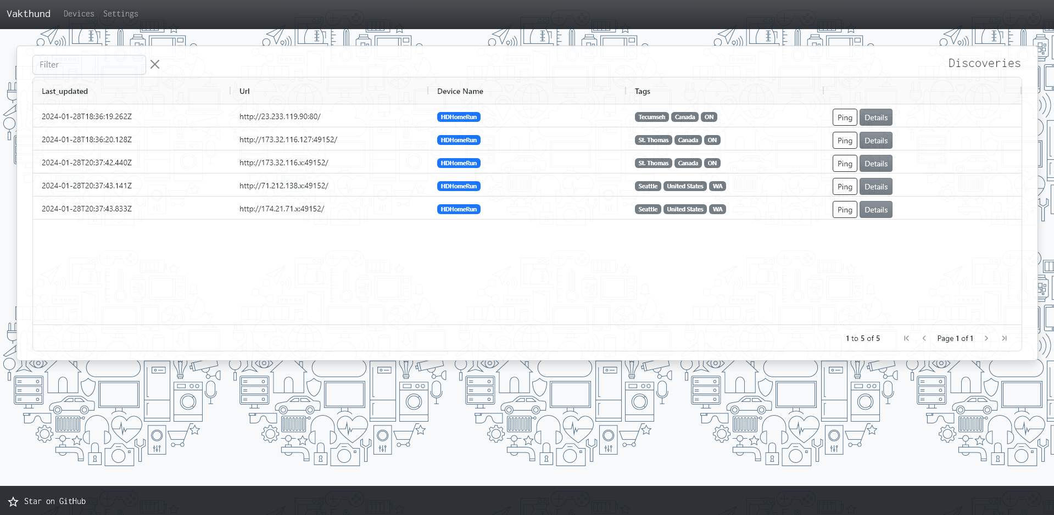
Slide 1
Java and Web Development
Project
Jesús León (M.N. 92126901)
Vakthund
Self-hosted web dashboard for security researchers to manage and track IoT devices obtained from public sources such as Shodan or ZoomEye. GitHub: https://github.com/leonrjg/Vakthund
Main features:
🟢 Periodically save hosts that match certain criteria on the search engines
🟢 Configure and execute actions targeting certain hosts
🟢 Choose what search engine to use for each device
🟢 Confirm whether a host is online directly on the web interface
🟢 Filter hosts by tag, device type or any related value
🟢 See the full result from the search engine on the web interface

Slide 2
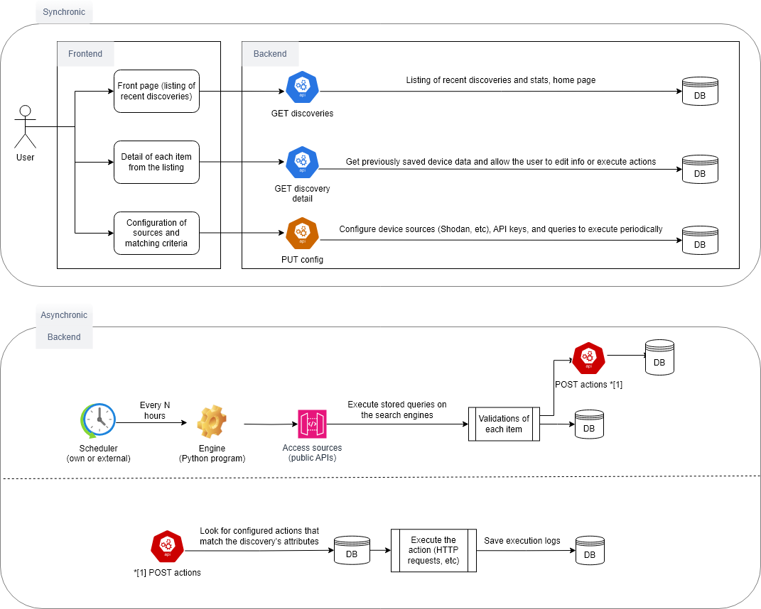
Slide 2
Architecture diagram
The web app is made up of 3 components: backend API, web interface and a background engine

Slide 3
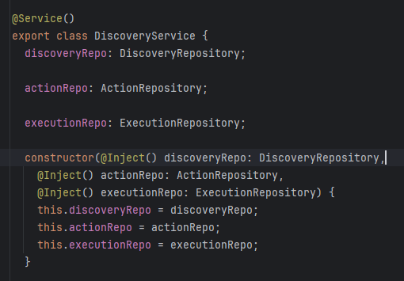
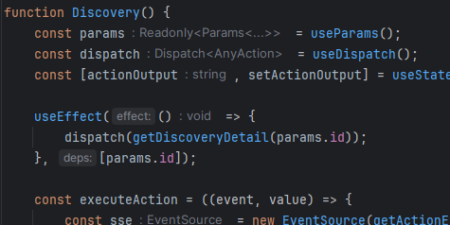
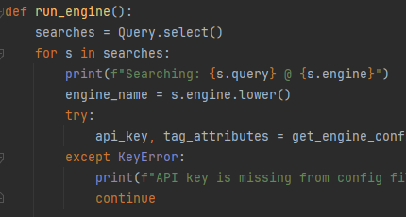
Slide 3
Technology choices
Backend
Node.js: Large community, flexibility.
DBMS-agnostic: support for MySQL/MariaDB, Postgres, and SQLite* (*default) thanks to the Sequelize ORM.
Express web server: De facto standard server framework for Node.js.
Frontend
React: Most popular web framework to build SPA interfaces. AGGridReact: fully-featured and highly customizable data grid with no third-party dependencies.
MUI Joy: Simple and functional UI components.
Engine
Python: most, if not all, IoT search engines give maintenance priority to their Python libraries, as it is a widely used language in the security field.
Peewee: ORM to ensure DBMS-agnostic functionality.

Slide 4
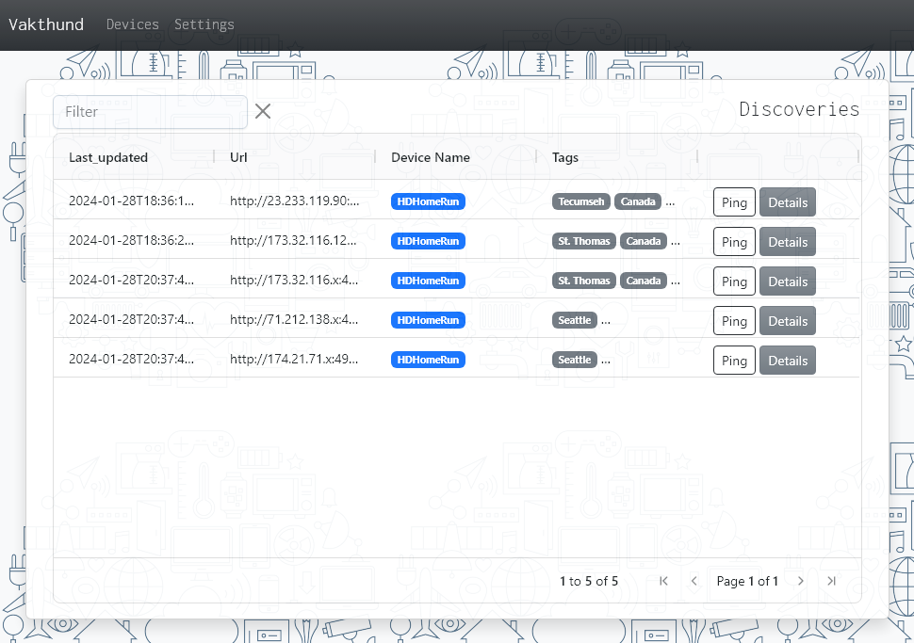
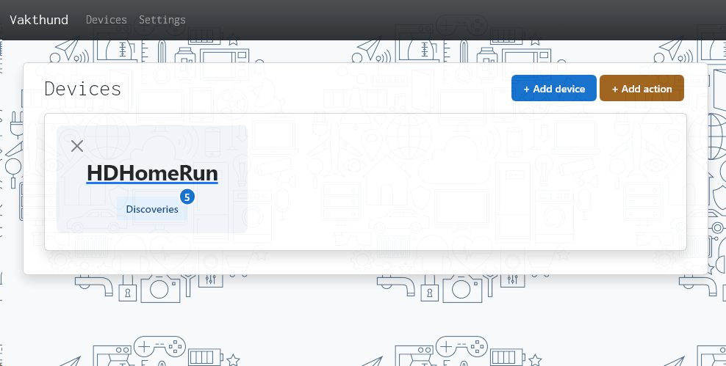
Slide 4
Screenshots
A
Filter and sorting-capable data grid containing the hosts saved from the search engines
B
Confirm whether the host is online directly on the web interface
C
Manage tracked devices
D
Configure actions for each device

Slide 5
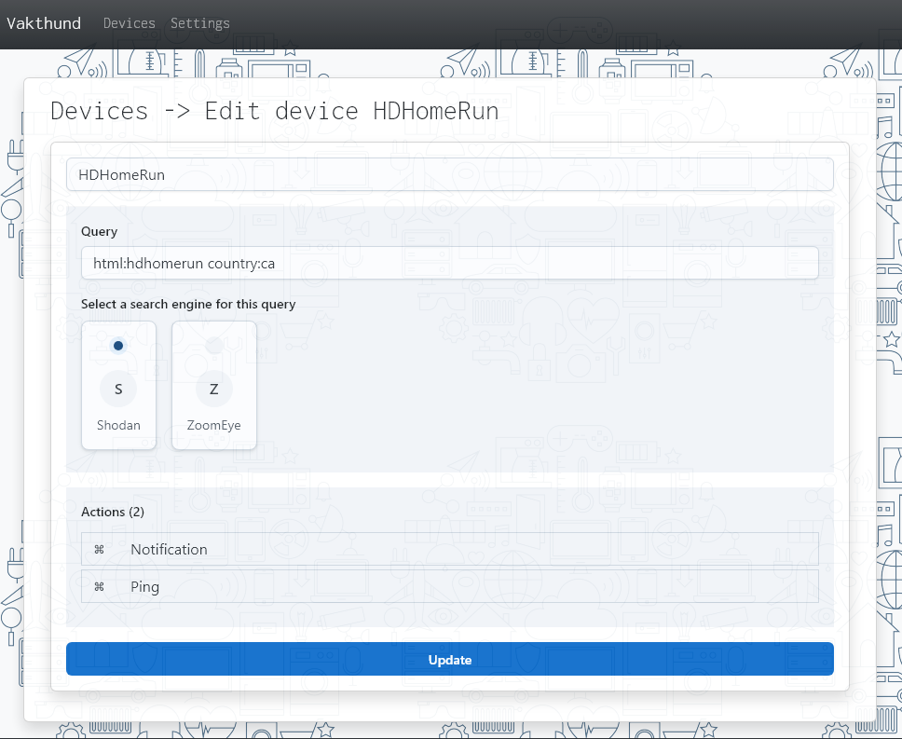
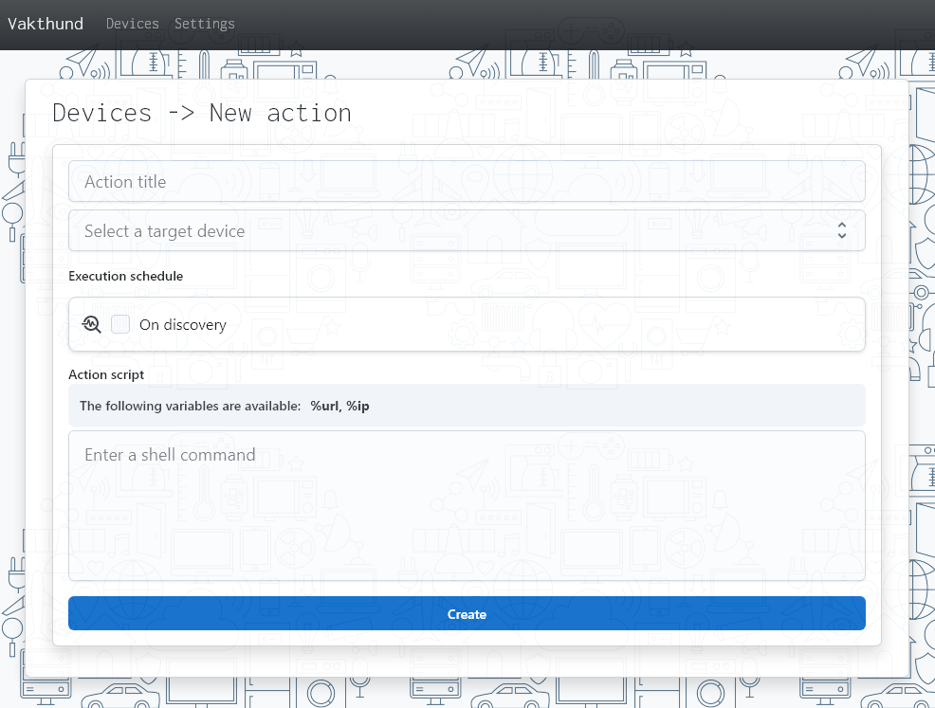
Slide 4
Screenshots
A
Choose what search engine to use for each device
B
See and edit device actions
C
Choose if the action should be executed automatically when a new host is discovered
D
Shell script support for actions with simple variable interpolation

Slide 6
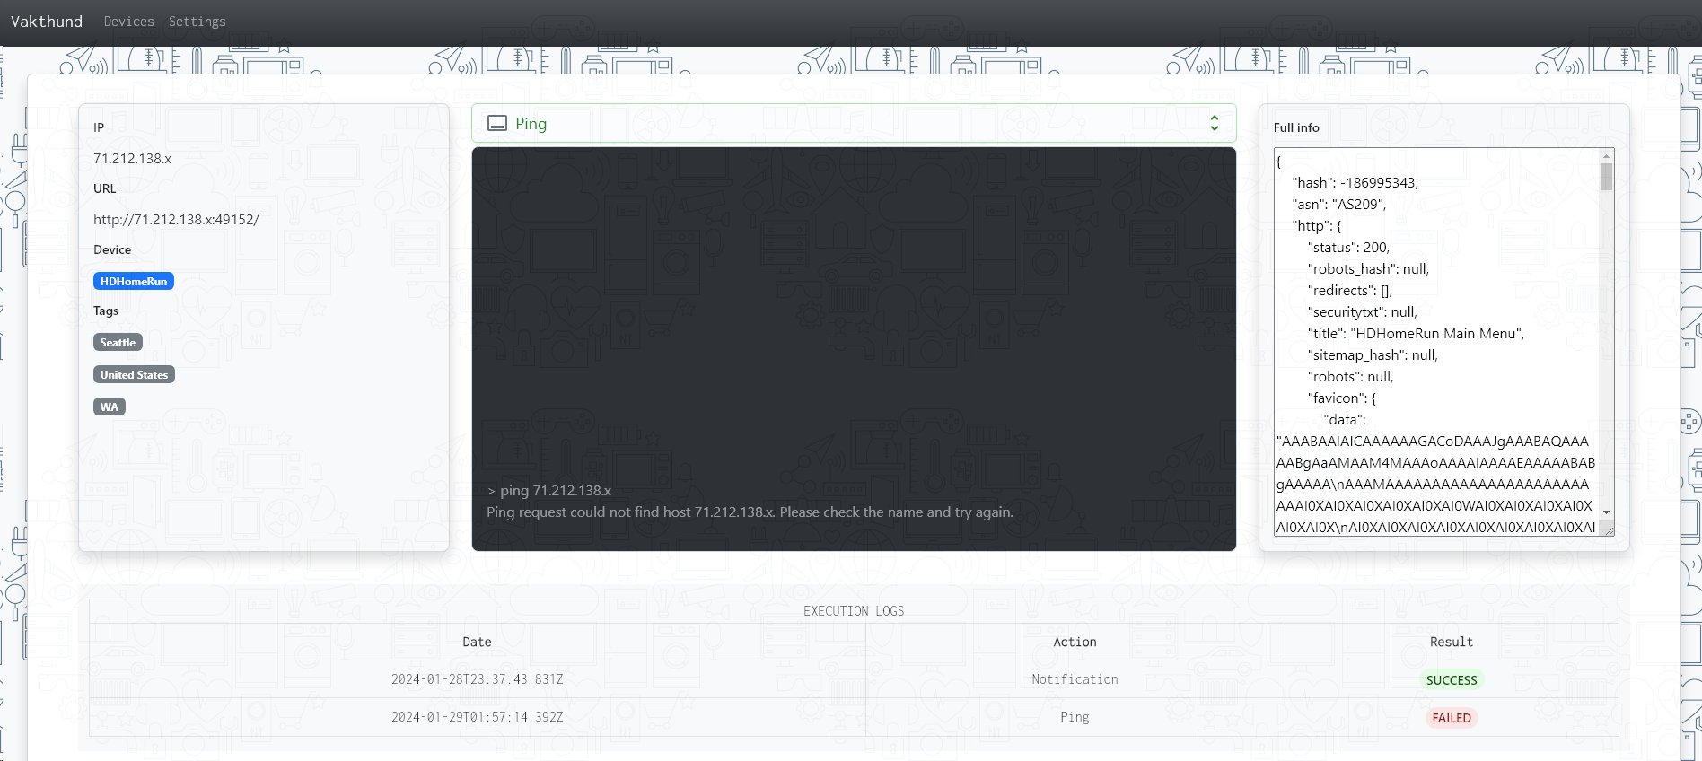
Slide 4
Screenshots
C
Execution logs
A
Real-time output of action executions
D
On-demand action execution
B
Full data from the search engine API

Slide 7
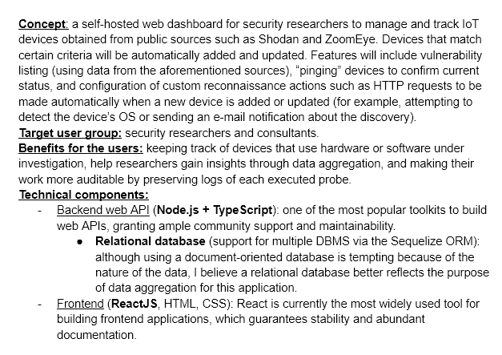
Slide 4
Changes compared to Phase 1
One highlighted feature from the conception phase was “vulnerability listing”, however, this is not always available in search engine APIs so it is often not possible to provide. When it is, it is shown in the ‘full data’ textarea on the “Details” page of a host.
Python is not mentioned in the conception document, yet it was unavoidable to use this language to write the component that gets data from search engines, given the priority that most of them give to their client implementations in Python. Such libraries in JavaScript were outdated and vulnerable.

Slide 8
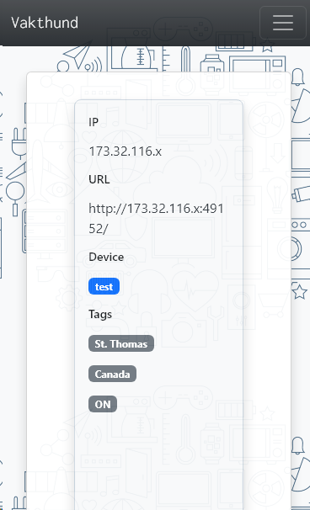
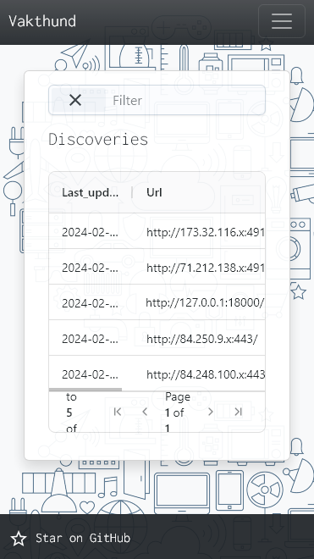
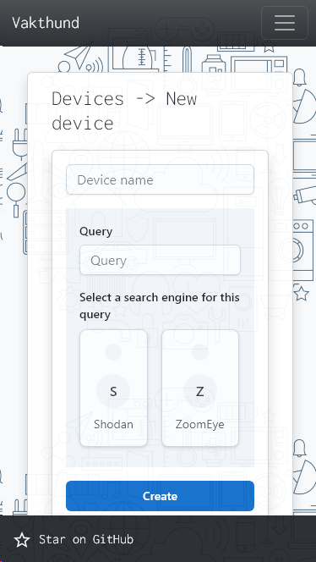
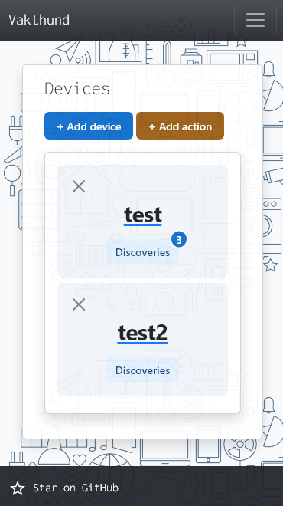
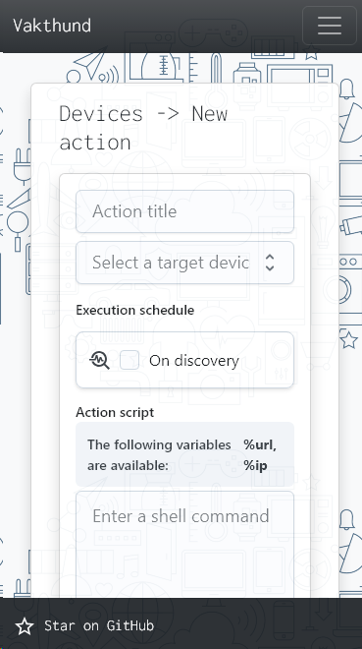

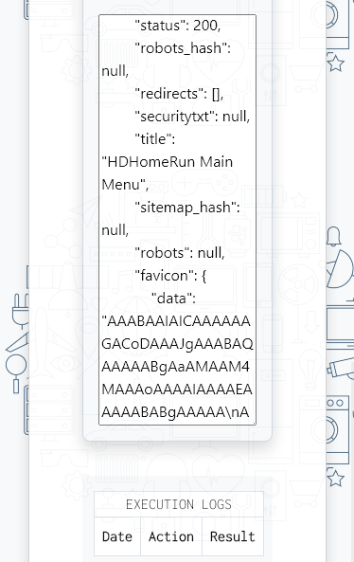

Slide 4
Responsiveness
Bootstrap’s grid system and AGGridReact’s grid sizing options were
leveraged to adapt the content to different viewports with little additional code.
iPhone SE (375x667 – smallest screen size on Chrome Devtools):

Slide 9
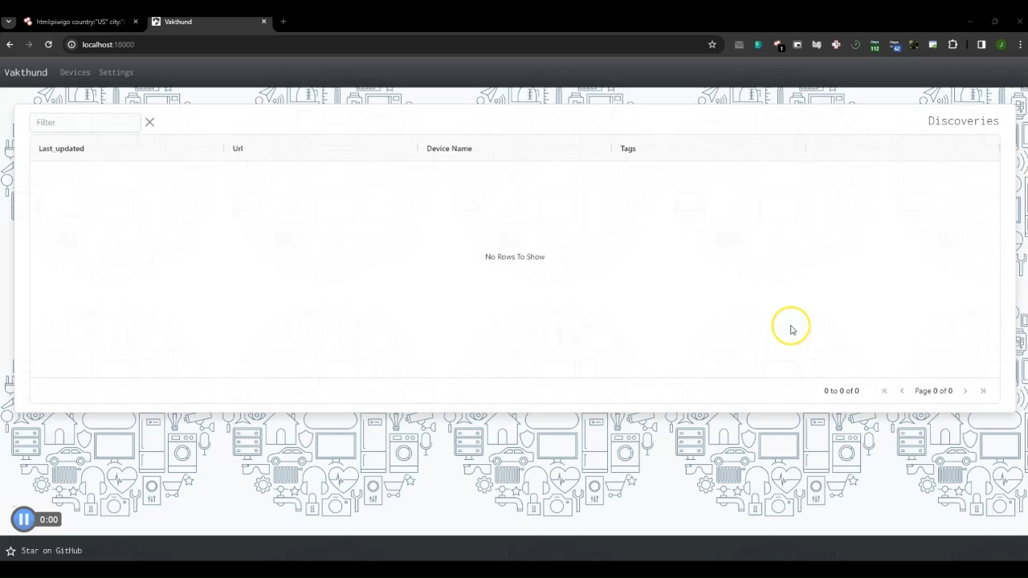
Slide 4
Screencast

Slide 10
Slide 4
Test cases
1) Actions: Go to the “Devices” page as seen on the top navigation bar; click “+ Add device”; enter any values in the “Device name” and “Query” fields; select any search engine and click “Create”. Expected result: user is redirected to “/devices” and the newly created device is visible on the previously empty “Devices” page. Note: the reason why the values used to create the device are random or meaningless is because it is assumed that the reviewer will not use search engine API keys and therefore they will need to resort to mock data (as explained shortly), which is inserted regardless of the device values. For a real test including API access, please refer to the screencast, or request an API key via any communication channel.
2) Actions: While on the “Devices” page, click on “+ New action”; fill out the form as follows and hit “Create”:
- Action title: “Ping”
- Target device: [select the previously created device]
- Leave “on discovery” unchecked (for a test of “on discovery”, please refer to the screencast).
- Action script: “ping %ip”
Expected result: user is redirected to “/devices/{id}”, where a device editing form and the new action are visible.
3) Actions: While on “/devices/{id}” (editing form), change the title of the device by modifying the first text field (“Device name”).
Expected result: redirection to the Devices page, where the new title is visible.
4) Actions: Open the command line; move to [root_project_directory]/vakthund-engine; assign any value to the “vk_use_mocks” environment variable (for example, “1”); execute “python main.py”; return to the browser and go to the homepage.
Expected result: the “Discoveries” table on the homepage is now populated with a few mock items.
5) Actions: still on the homepage, click on the “Healthcheck” button of all the rows on the table.
Expected result: the button’s text now says “Offline” on 2 of the 3 rows, and “Online” (in green) on the row with the URL “http://127.0.0.1:18000/”.
6) Actions: still on the homepage, click the “Details” button of any row; open the “Execute an action” dropdown; select “Ping”.
Expected result: view the command output in real time within the black box; a new row is added to the “Execution logs” table describing the execution that just took place.
7) Actions: go to the “Devices” page; click on the “X” button within the device card; confirm upon prompt; return to the homepage.
Expected result: the “Devices” page is empty again and the device-related data is gone (there are no rows on the homepage anymore).

